Slide 1


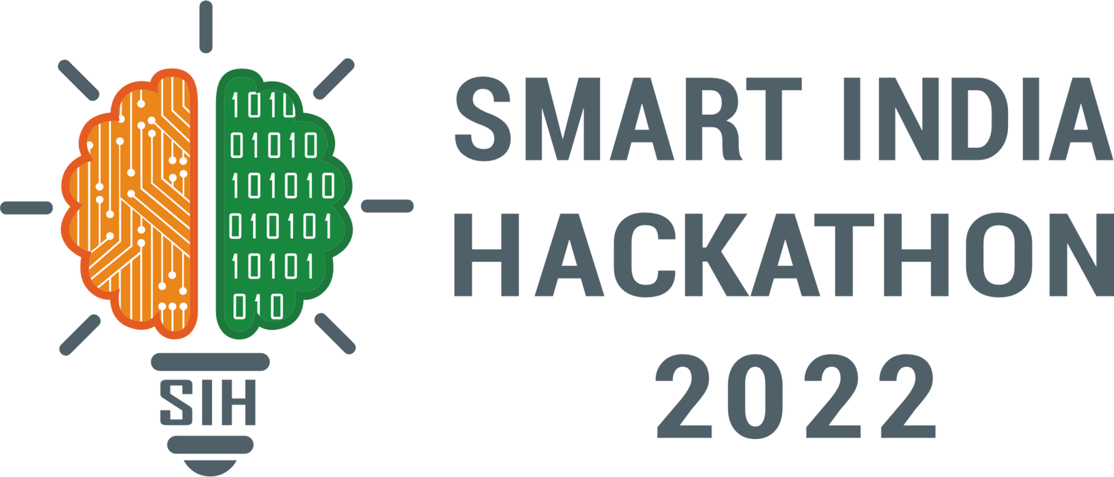
SMART INDIA HACKATHON 2025
TITLE PAGE
Problem Statement ID : SIH25040
Problem Statement Title : FloatChat - AI-Powered Conversational Interface for ARGO Ocean Data Discovery and Visualization
Theme - Miscellaneous
PS Category- Software
Team ID -
Team name - Ocean_Quest

Slide 2

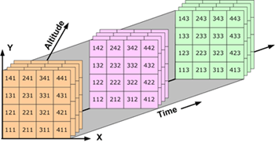
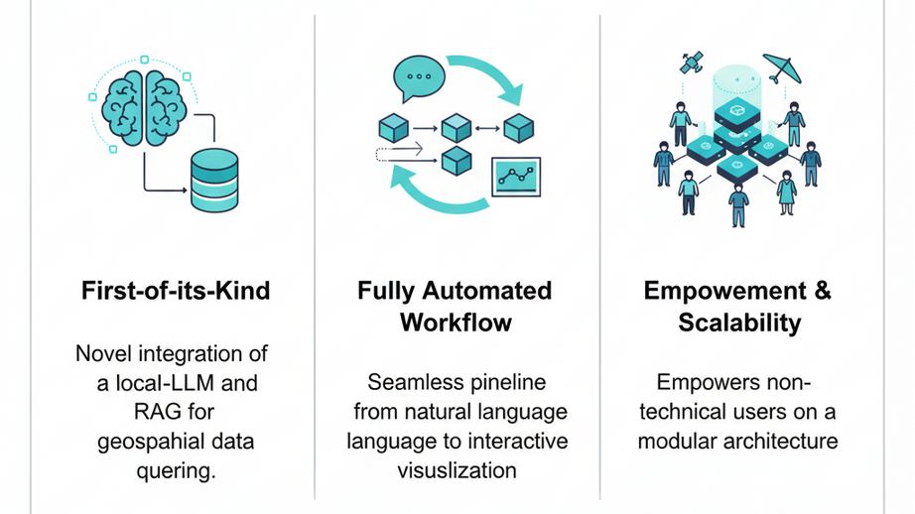
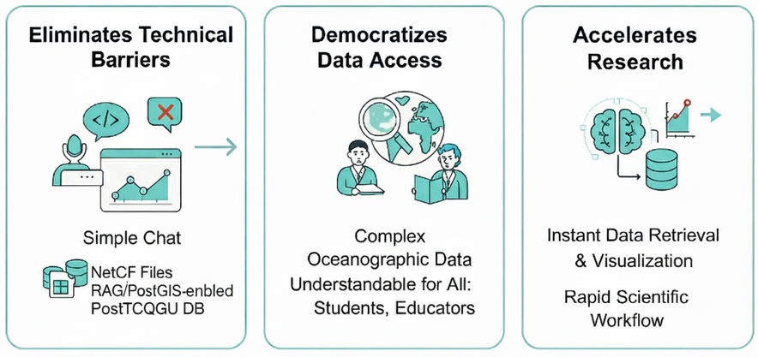
Ocean_Quest
FloatChat - Ai
❖ Proposed Solution
AI-Powered Dashboard: An intuitive conversational interface built with Streamlit for seamless ARGO data exploration.
Automated Data Pipeline: Converts complex NetCDF files into a query-ready, PostGIS-enabled PostgreSQL database.
AI Core (Text-to-SQL): Employs a local LLM (Ollama) and a RAG pipeline with a ChromaDB vector store to translate plain English questions into precise SQL queries.
Instant Visualization: Automatically generates interactive geospatial maps, depth profiles, and time-series charts using Plotly.
❖ How It Addresses the Problem
Eliminates Technical Barriers: Replaces the need for coding and specialized software with a simple chat interface, removing the steep learning curve.
Democratizes Data Access: Makes complex oceanographic data understandable for non-experts like students, policymakers, and educators.
Accelerates Research: Provides instant data retrieval and visualization, dramatically speeding up the scientific workflow from hours to seconds.
❖ Innovation & Uniqueness
2
Notes:
2

Slide 3
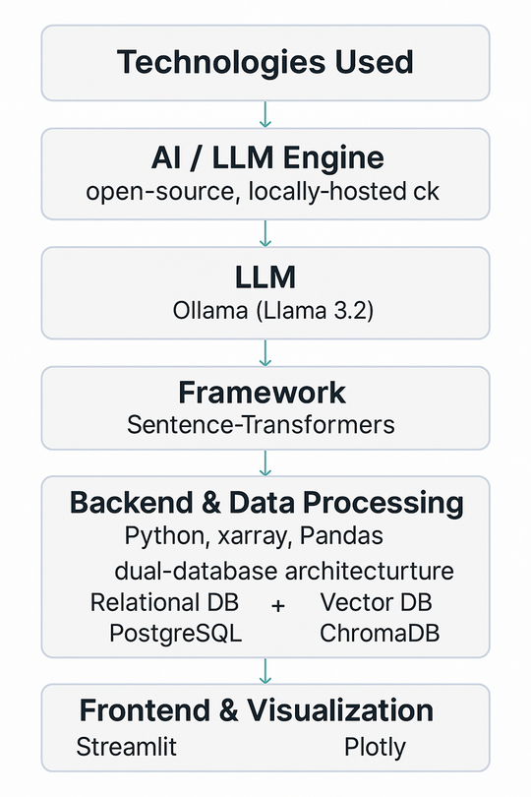
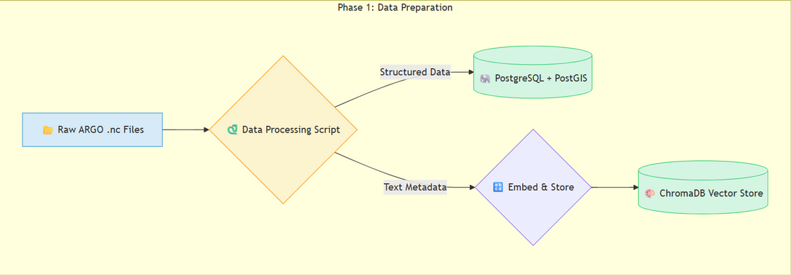
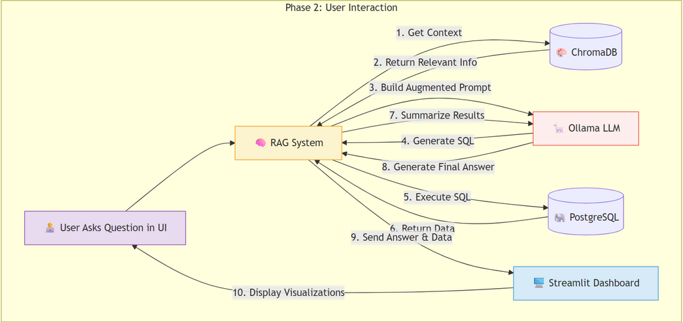
Ocean_Quest
TECHNICAL APPROACH
❖ Technologies Used
AI/LLM Engine: LangChain orchestrating a locally-hosted Ollama (Llama 3.2) for Text-to-SQL generation and Sentence-Transformers for RAG embeddings.
Backend & Data: Python with xarray for NetCDF parsing and Pandas for data manipulation.
Database: A dual-database architecture using PostgreSQL + PostGIS for structured geospatial data and ChromaDB for vector search.
Frontend & Visualization: Streamlit for the interactive dashboard and chatbot, with Plotly for dynamic charts and maps.
❖ Methodology and Process (Implementation Flow)
We implemented an end-to-end RAG pipeline that translates natural language into data insights, following two core workflows:
1. One-Time Data Ingestion (ETL):
Raw ARGO NetCDF files are processed, extracting and cleaning time-series and profile data.
The structured data is bulk-loaded into PostgreSQL.
Key metadata for each float is embedded and indexed in ChromaDB to power our context retrieval.
2. Real-Time Query Lifecycle:
A user enters a plain English query into the Streamlit chatbot.
The query is vectorized and sent to ChromaDB, which performs a semantic search to retrieve the most relevant metadata context.
An augmented prompt is created, combining the user's query, the retrieved context, strict rules, and examples of correct SQL.
This detailed prompt is sent to the Ollama LLM, which generates a precise, PostGIS-enabled SQL query.
The query is executed on PostgreSQL, fetching the exact data required.
The data is displayed as interactive visualizations and is also passed back to the LLM to generate a concise, human-readable summary.
The user receives the final AI-generated insight and interactive charts on the dashboard, completing the seamless "Question to Visualization" loop.
3
Notes:
3

Slide 4
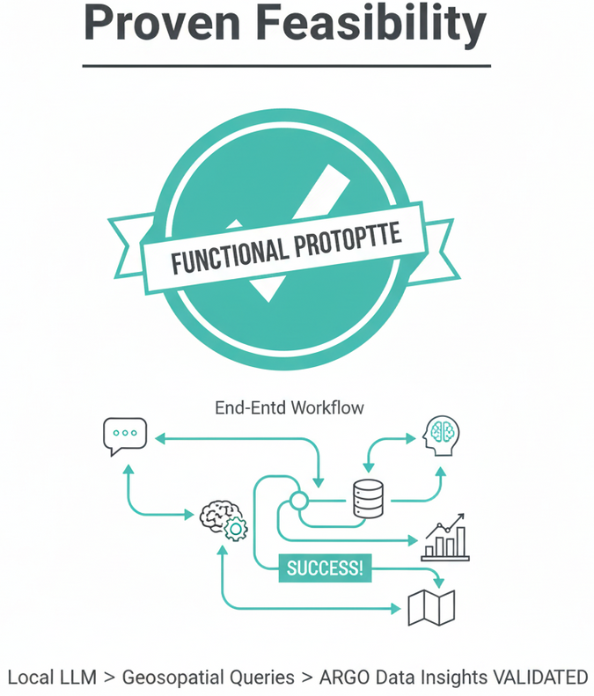
Ocean_Quest
FEASIBILITY AND VIABILITY
❖ Feasibility and Viability
Proven Feasibility: The concept is not just theoretical; we have successfully developed a functional end-to-end prototype. Our working model validates that a local LLM can effectively translate natural language into complex geospatial queries for ARGO data.
Technologically Viable: The solution is built exclusively on a mature, open-source stack (Python, PostgreSQL, LangChain, Ollama), ensuring zero licensing costs, wide community support, and complete control over the pipeline.
Modular and Scalable Architecture: The system is designed with a clear separation of concerns (data pipeline, AI core, frontend), allowing for future scalability and easy integration of new datasets or more powerful LLMs.
❖ Potential Challenges & Risks
LLM Accuracy and Hallucination: The primary risk is the LLM generating incorrect or inefficient SQL for highly complex or ambiguous user prompts, a common challenge in Text-to-SQL applications.
Scalability for Production Use: Handling petabyte-scale datasets and a large number of concurrent users would require significant infrastructure beyond the current local deployment.
Data Heterogeneity: Integrating new and diverse data sources (e.g., satellite imagery, unstructured cruise reports) will require developing custom data processing modules.
❖ Mitigation Strategies
Advanced Prompt Engineering: We mitigate LLM errors through a robust prompting strategy, including:
Few-Shot Prompting: Embedding examples of correct, efficient SQL directly into the prompt to guide the AI.
Rule-Based Guardrails: Implementing strict, explicit rules that constrain the AI's output and prevent common failure modes.
Cloud-Native Deployment: For production scale, the application is designed to be containerized using Docker. This allows for seamless deployment on any cloud platform (AWS, GCP, Azure), leveraging managed databases and scalable compute resources.
Modular ETL Framework: We will address data heterogeneity by designing a plug-in style data processing framework, where new modules for different data sources can be added without altering the core application logic.
@SIH Idea submission- Template
4
Notes:
4

Slide 5
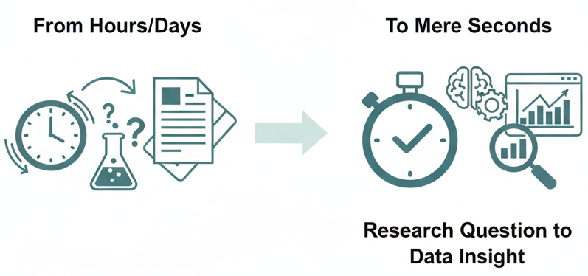
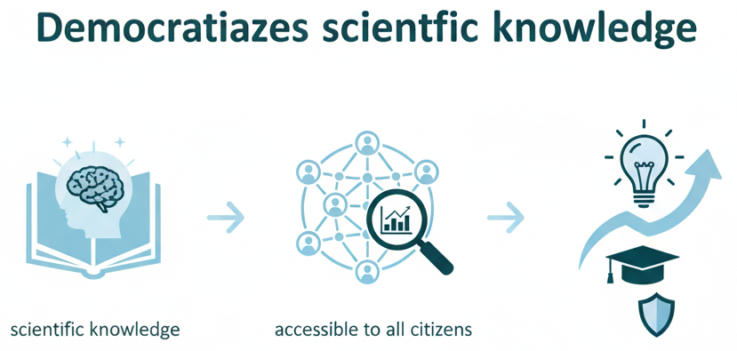
Ocean_Quest
IMPACT & BENEFITS
❖ Impact and Benefits
For Researchers & Scientists: Accelerates Discovery by reducing the time from research question to data insight from hours or days to mere seconds.
For Students & Educators: Creates an interactive learning tool, transforming oceanography education from static textbooks into a dynamic, hands-on exploratory experience.
For Policymakers & Government Agencies: Enables data-driven governance by providing direct access to ocean data for informed decisions on climate policy, disaster management, and maritime security.
For the Public: Increases Climate Literacy by making complex climate data accessible and understandable, fostering public engagement with ocean science.
❖ Benefits of the Solution
Social & Educational Benefit: Democratizes scientific knowledge by making a vital national data asset accessible to all citizens, fostering a more informed and scientifically literate society.
Environmental Benefit: Enhances climate change monitoring by providing rapid access to key ocean health indicators (temperature, salinity), crucial for tracking global warming trends and validating climate models.
Economic Benefit: Supports India's Blue Economy by providing valuable data for sectors like fisheries management, shipping route optimization, and resource exploration, improving efficiency and sustainability.
Strategic Benefit: Aligns with National Missions like the "Digital India" initiative and the "Deep Ocean Mission" by building indigenous capacity in AI-driven data analytics for a critical national domain.
5

Slide 6

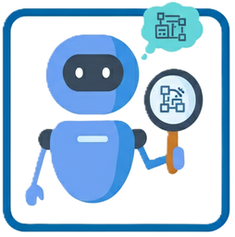
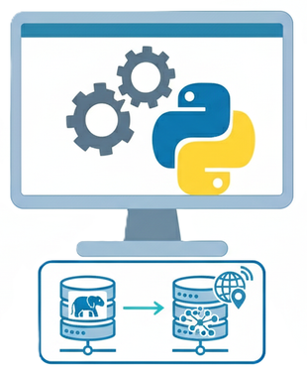
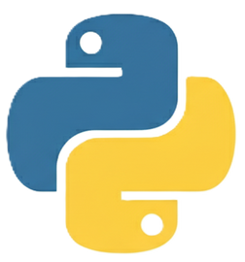
Ocean_Quest
Research & References
❖ Oceanographic Data & Standards
Argo Data Management Portal: https://argodatamgt.org/
Argo Float Data Handbook: https://argodatamgt.org/wp-content/uploads/2024/02/argo-data-management-handbook.pdf
NetCDF (Network Common Data Format): https://www.unidata.ucar.edu/software/netcdf/
❖ AI Methodologies & Models
Retrieval-Augmented Generation (RAG) Paper: https://arxiv.org/abs/2005.11401
LangChain Framework (AI Orchestration): https://python.langchain.com/
Ollama (Local LLM Serving): https://ollama.ai/
Sentence-Transformers (Embeddings): https://www.sbert.net/
Hugging Face Hub (Model Source): https://huggingface.co/models
❖ Database & Backend Technologies
PostgreSQL & PostGIS (Database): https://www.postgresql.org/ & https://postgis.net/
ChromaDB (Vector Store): https://www.trychroma.com/
SQLAlchemy (Python SQL Toolkit/ORM): https://www.sqlalchemy.org/
GeoAlchemy2 (Geospatial ORM Extension): https://geoalchemy-2.readthedocs.io/
❖ Core Python Libraries & Frontend
Streamlit (Dashboard Framework): https://streamlit.io/
Plotly (Interactive Visualizations): https://plotly.com/python/
xarray (N-D Labeled Arrays): https://docs.xarray.dev/
Pandas (Data Analysis & Manipulation): https://pandas.pydata.org/
6

